Slide 1
Fundamental Python

Slide 2
In this presentation…
About Me!
About the course
About Python
Why Python?
Accessing resources
Accessing me
How to get setup

Slide 3

About Me
Background in Mathematics
Teaching Python for 8 years
Currently work as a PGR studying
applying AI to biological data
Also a freelance web developer!

Slide 4
About The Course
10 weeks, 2hr/week
Practice and project driven introduction to the Python programming language.
Aim to equip you with the tools and confidence to learn specific tools to achieve your goals.

Slide 5
About The Course
Introduction: Why Python?
Control Flow
Iteration
Functions
File I/O
Classes & OOP
Packages
Good Development
Regex
Final Projects

Slide 6
About Python
First released in 1991, high level, interpreted, general-purpose programming language
Currently the 2nd most used programming language in industry*
* From https://survey.stackoverflow.co/2022/, not including HTML/CSS, SQL!

Slide 7
Why Python
Extremely helpful community with plenty of resources (hello!).
Versatile, accessible language.
Standard language for AI, web development backend and scripting.
Great transition for other languages

Slide 8
What do you want to program for?

Slide 9

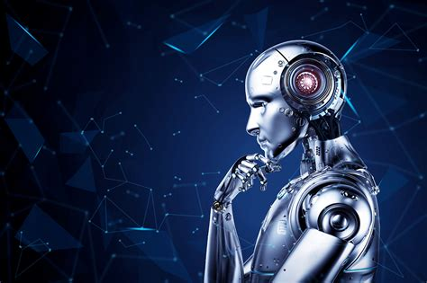
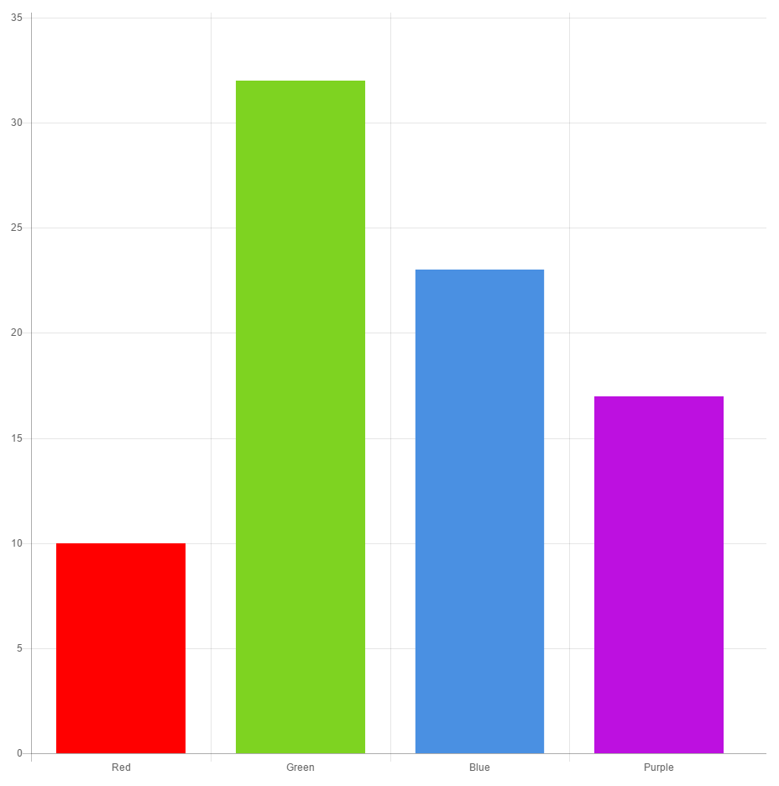





Slide 10
Accessing Resources
All resources are available here:
https://github.com/stmball/Continuing-Education

Slide 11
Accessing Me
Please, please, please, please, please:
IF YOU HAVE ANY QUESTIONS/ISSUES
LET ME KNOW!!!!
sballstf@liverpool.ac.uk

Slide 12
Let’s Get Started!

Slide 13

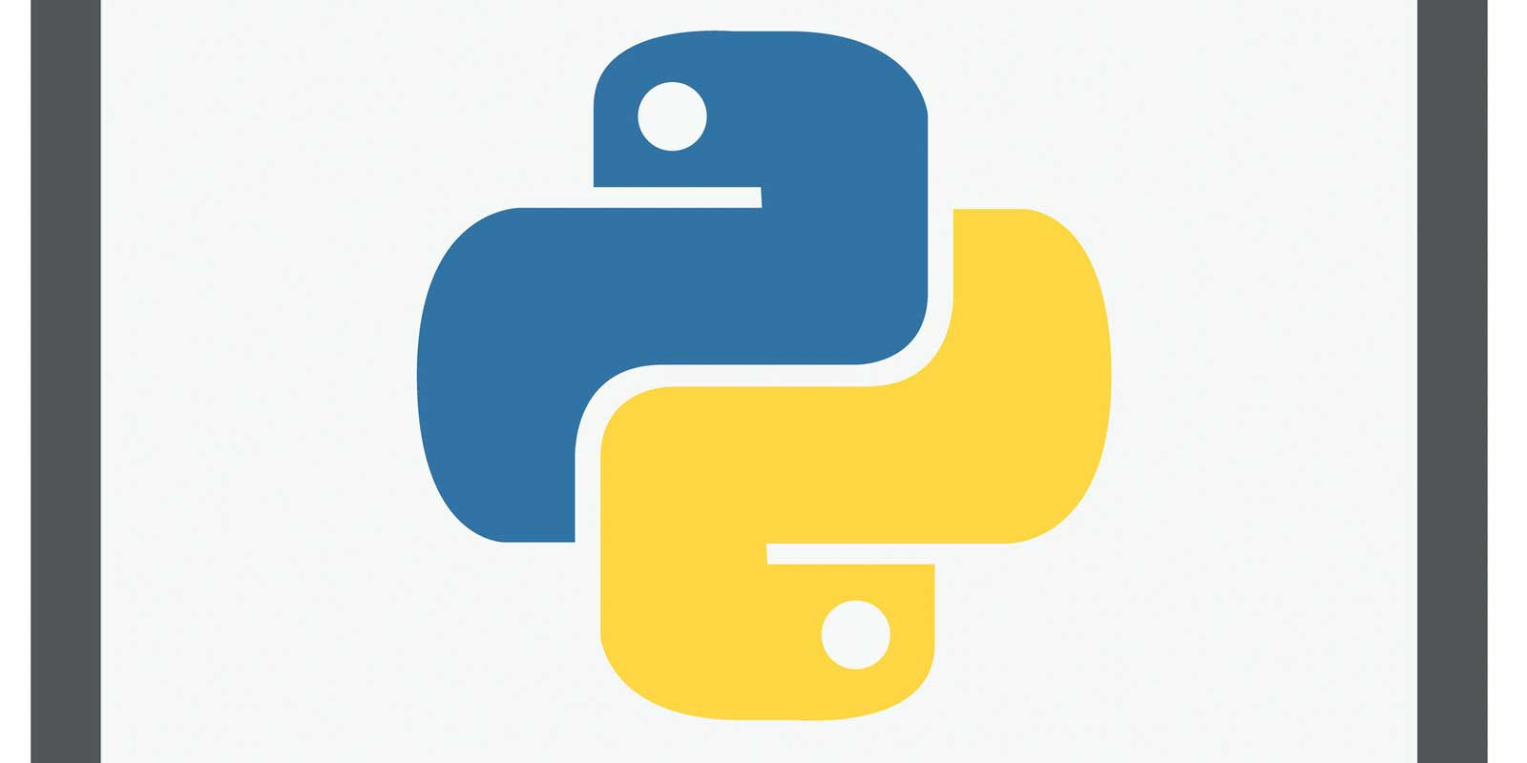


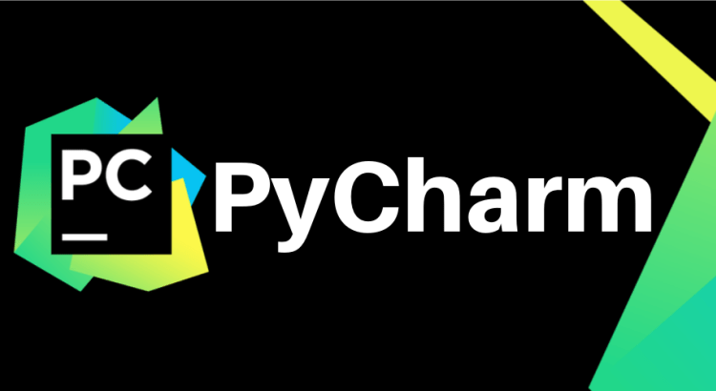

Setup Options
Step 1
Step 2
Step 3

